Slide 1
Network with TCP/IP
Overview for Interviews

Slide 2
Agenda
TCP/IP Layers and their address
Physical /Link/MAC/Hardware address
Logical Address / IP address
Classes of IPv4 addresses/classful IPv4 addressing
Port Numbers
Connecting Devices(DCE’s) :
Repeater,
Hub,
Bridge,
Switch,
Router
Gateway,
Modem
CSU/DSU

Slide 3
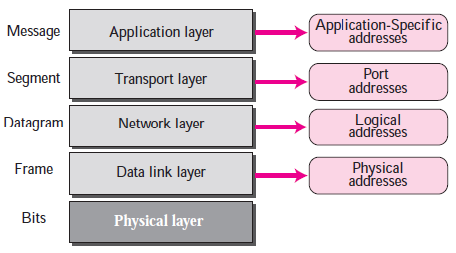
TCP/IP Layers and Their Addresses

Slide 4
Physical/Link/Hardware/MAC Address
I
It is a 48-bit address address.
It is represented as a 6 byte/octet hexadecimal number , where in each byte may be within the range 00 to FF.
It is a globally unique address assigned to a commercial NIC.
This address type may be unicast,multicast,broadcast.
If lsb of first byte(B1) is 0 then address is unicast

Slide 5
If lsb of first byte(B1) is 1 then address is multicast
If all bytes are FF then address is ONLY destination broadcast address and never assigned to any network adaptor.
If all bytes are 00 then address is ONLY source address is also never assigned to any network adaptor.
The first 3 bytes are manufacture ID bytes , & the next 3 bytes are unique CARD ID bytes under one manufacturer ID bytes.

Slide 6
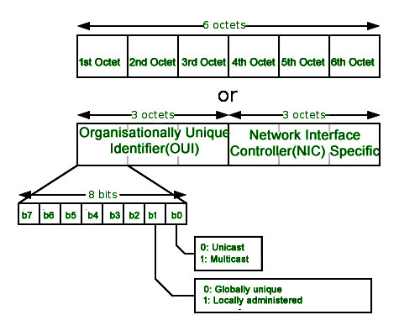

Slide 7
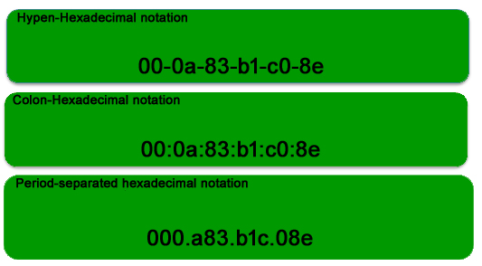

Slide 8
Logical Address
Also called as Internet Protocol (IP) Address
Currently 2 versions are in use : IPv4 & IPv6/IPng
IPv4:
It is 32 bit address
It is represented as a 4 byte/octet dotted decimal number , where each byte is with 0 – 255 range . Example 1.2.3.4.
There are two groups of IPv4 address namely private IPv4 addresses & public IPv4 address.

Slide 9
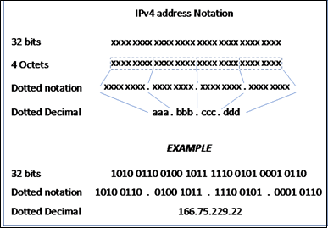

Slide 10
Private IPv4 address
Given and maintained by Local System/Network Administrator using rules
Used for Host to Host communication/networking Within LAN
Are non commercial
Locally Unique for any Host within particular LAN

Slide 11
Public IPv4 address
Given & maintained by ISP using rules
are commercial
Used for Host to Host Communication in two separate network connected through ISP.
Public IP is usually shared by a group/all hosts of a particular LAN.
Hence a host may have & use two IPv4 addresses , a private IPv4 for local communication , and a public IPv4 address for global communication.

Slide 12
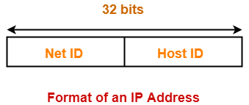
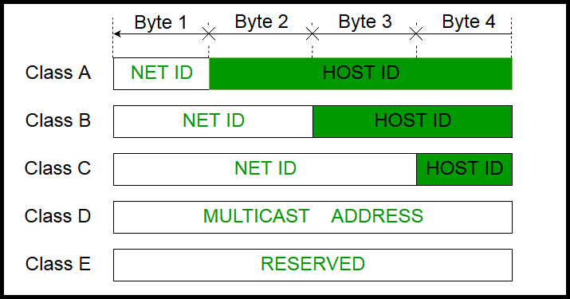
Classfull IPv4

Slide 13
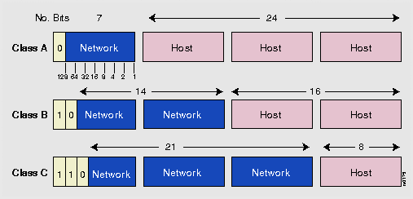
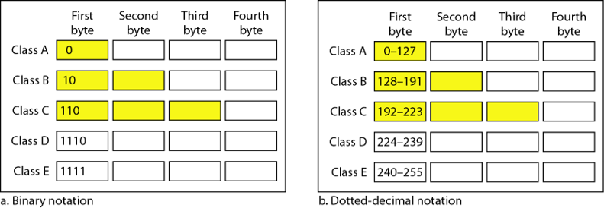

Slide 14
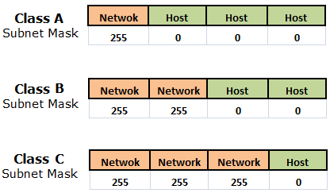
Default Subnet Masks (Special IPv4 Addresses)

Slide 15
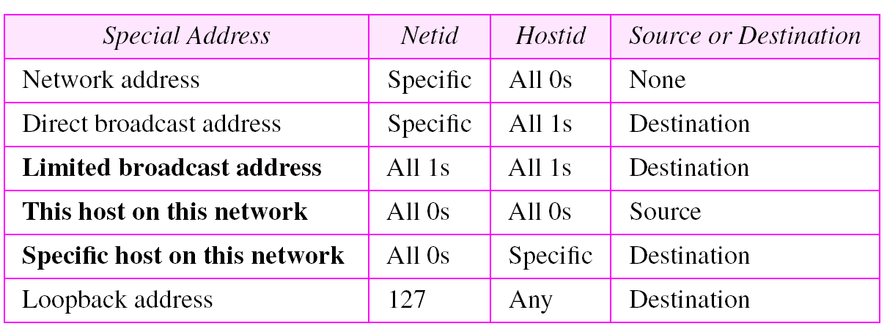
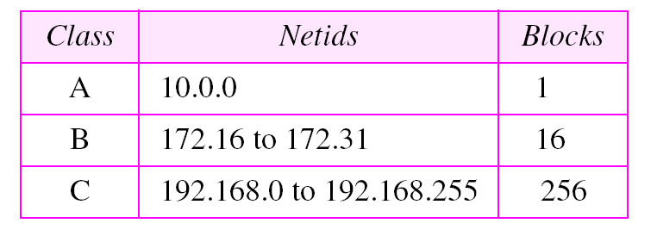
More Special IPv4 Addressess

Slide 16
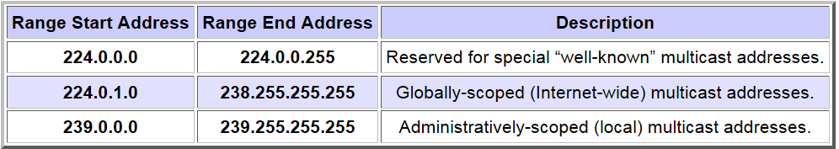

Slide 17
PORT ADDRESS/NUMBER
A port number is a way to identify a specific process/connection in a specific process(client/server) that wants communicate using TCP/IP network in a particular Host .
It a 16-bit unsigned short integer (0 – 65535) number .
Two or more processes/connections in the same process CANNOT use the same port number at the same time.
Hence port number is unique for a process/connection in a particular Host.
The sum total of processes/connections using TCP/IP network in a particular host is limited by this number.

Slide 18
PORT Number Ranges
0 – 65535
port numbers 0 to 1023 are reserved for privileged services and designated as well-known ports.
Port numbers 1024 – 49151 are referred to as registered / registerable ports.
Port numbers 49152 – 65535 are referred to as open/dynamic/ephemeral ports.
TRANSPORT LAYER DEALS WITH PORT NUMBERS

Slide 19
Connecting Devices
DCEs

Slide 20
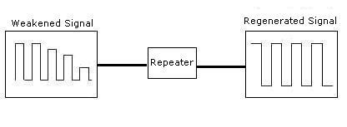
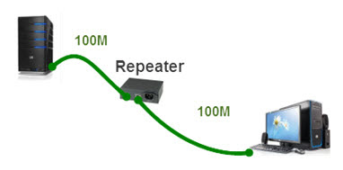
Repeater

Slide 21
It is two port device.
It is used for extending the distance of interconnectivity between two DTEs in the event of signal attenuation/drop/weakened
between them.
It non intelligent as does help in managing network traffic & does not deal with any addresses.

Slide 22
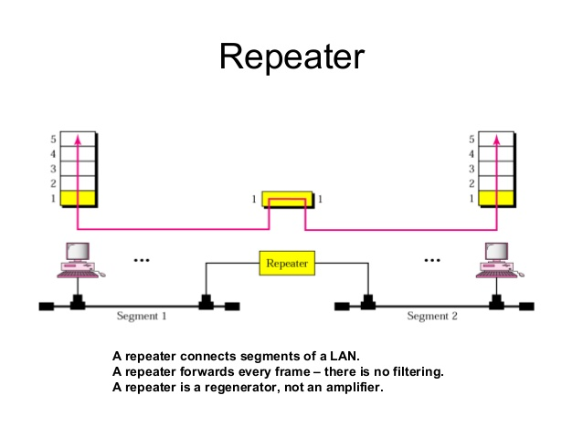

Slide 23
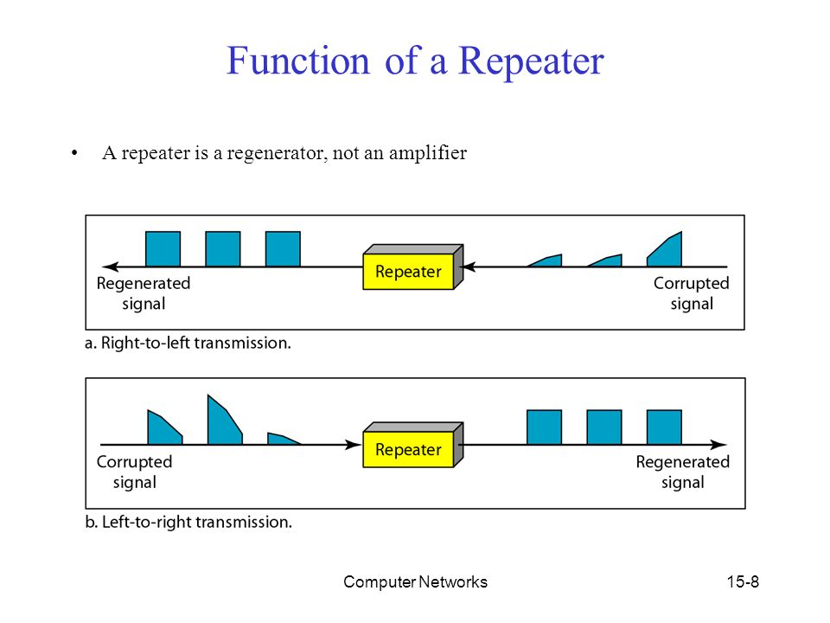

Slide 24
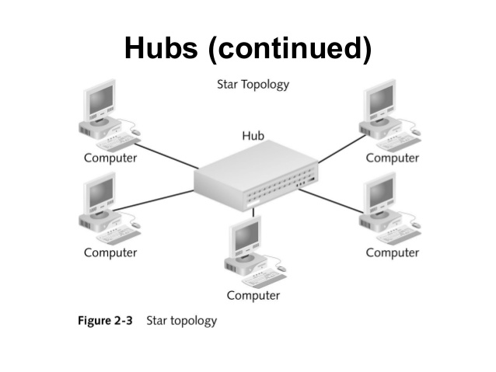

Slide 25
HUB
Is a multiport Repeater used for interconnecting multiple hosts using star topology.
Whatever information sent by any host arrives at the bridge’s one port and copies it to the rest of all other ports(BROADCAST).
It is a non intelligent device , since it does not deal with addresses during communication and hence does not manage network traffic.

Slide 26
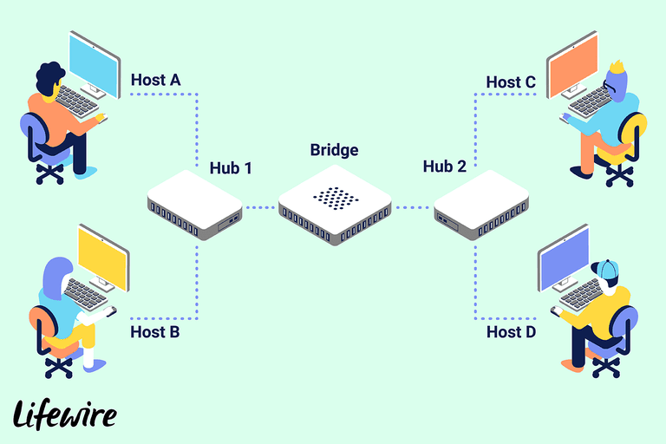
BRIDGE

Slide 27
BRIDGE
Bridge is a device which divides a LAN into 2 separate collision/broadcast domains.
Thus It helps in managing network traffic to some extent. ( Refer : FIG2 )
Collision Domain refers the area/region/boundary of any network that can accommodate as many hosts as possible which can comfortably communicate with each other, WITHOUT more time spent in retransmissions due to collisions , THAN ACTUAL transmissions.

Slide 28
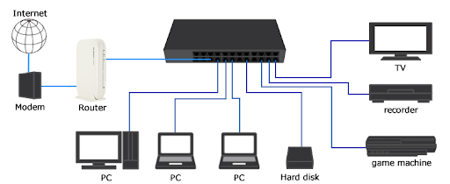
SWITCH

Slide 29
Switch
Switch is a multi-interface bridge
It divides the network into several collision/broadcast domain.(Refer PIC/Image 4)
Hence it manages network traffic in more better way.
It also deals with physical addresses ONLY , and maintains a switch table , to help manage traffic.
The intelligence of switch can be explained using the terms learning,flooding,forwarding,filtering,aging.

Slide 30
Router
Is a device used for interconnecting 2 or more networks (which are using different network addresses) BUT physical communication technologies of all the networks are SAME.
It forwards/routes data from one network to another network based on their IP address.
Routers help forward information from source host in one network directly or indirectly(using a chain of routers) to a destination host in another network.

Slide 31
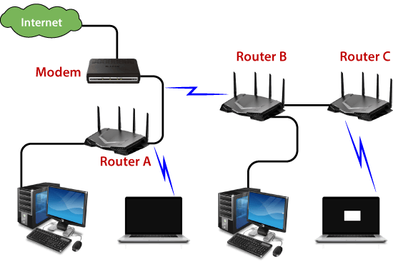
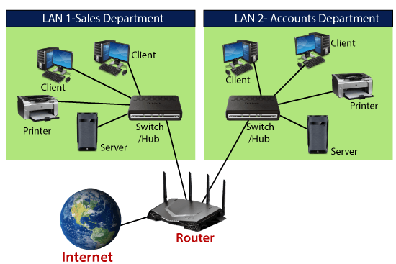

Slide 32
Router continued
Router consistently deal with IP addresses & MAC addresses to forward/route information in smallest path(route) among several paths(routes) if available.
Any routing path will involve atleast 2 DTEs(source & destination hosts) and 1 or more(chain of) DCEs (routers)
Gateways are special Routers which can interconnect 2 or more networks BUT physical communication technologies of the networks my be DIFFERENT.

Slide 33
NAT Enabled Router/Gateway
When routers additional deal with port number , in their forward process , then it is referred to as NAT Enabled router.
NAT Enabled routers deal with PORT FORWARDING (i.e. Intranet to Internet & vice-versa communication for private & public IP mapping.
Because of NAT a single public IP can be shared among several private IPs & connections simulataneously.
Refer urls : NAT , Port Forwarding
https://www.youtube.com/watch?v=FTUV0t6JaDA
https://www.youtube.com/watch?v=2G1ueMDgwxw

Slide 34
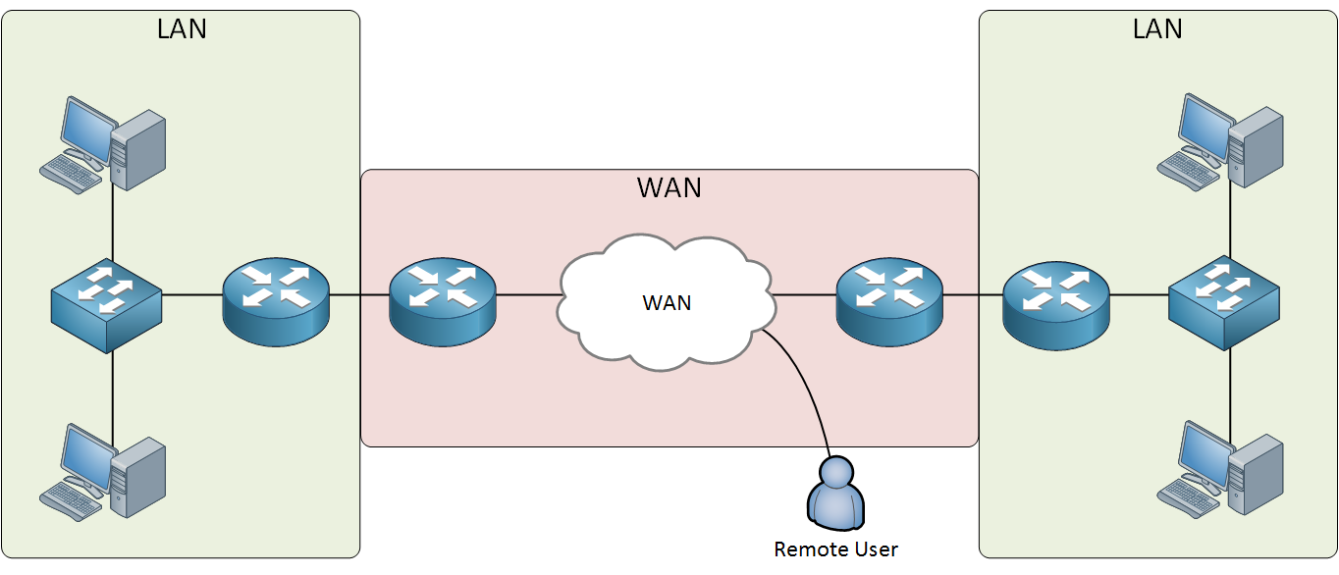
Summing Up LAN vs WAN

Slide 35
Modem
Is a device which brings the internet into your home or business.
It establishes and maintains a dedicated connection to ISP to give us access to the internet.
Internet uses analog signal , where as computers use digital signal hence a Modem comes between.
Modem demodulate incoming analog signal from internet in digital signal for computer.
And modulates outgoing digital signal from computer to analog signal for internet.
Refer url : (Modem vs Router )
https://www.youtube.com/watch?v=Mad4kQ5835Y

Slide 36
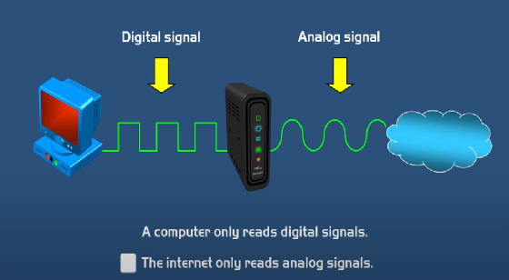
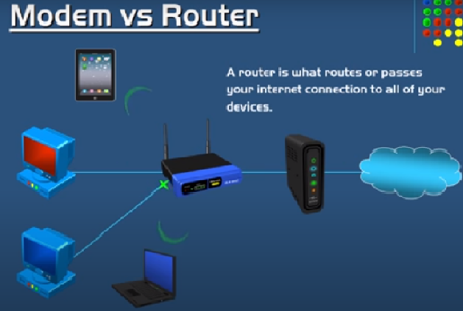

Slide 37
Routers & Modem may also come in the same package as a single device.

Slide 38
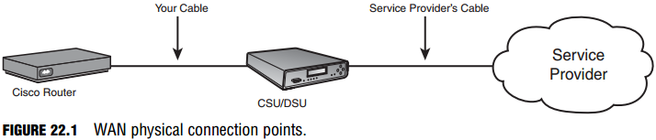
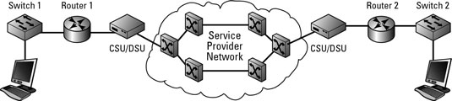
CSU/DSU

Slide 39
CSU/DSU
Channel Service Unit/Data Service Unit sit between the ISP connection and the router.
CSU – connects to the network provider
DSU – connects to router
Used for managing the speed of internet connection being provided by ISP to clients based on their opted subscription.

Slide 40
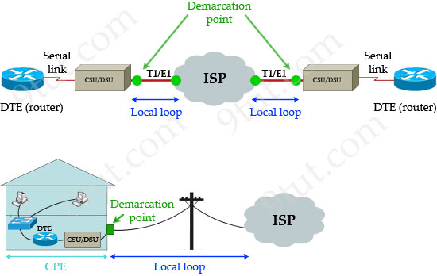

Slide 41
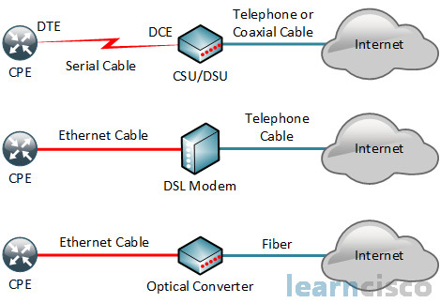
WAN Technologies & Connectivity

